Slide 1
Control System Requirements
Control
Pitch, Roll, and Yaw
Depth
Velocity
Criteria:
Settle Time: 5 seconds
Overshoot: 10%
Reject Step Disturbance
Image Solidworks With Axes
Add accuracy requirements

Slide 2
Plant Analysis
Drag makes system non-linear, therefore harder to develop a controller
Linearize Plant around specific operating points
develop controllers individually and use gain scheduling
Diffeq.png
plantBode.png

Slide 3
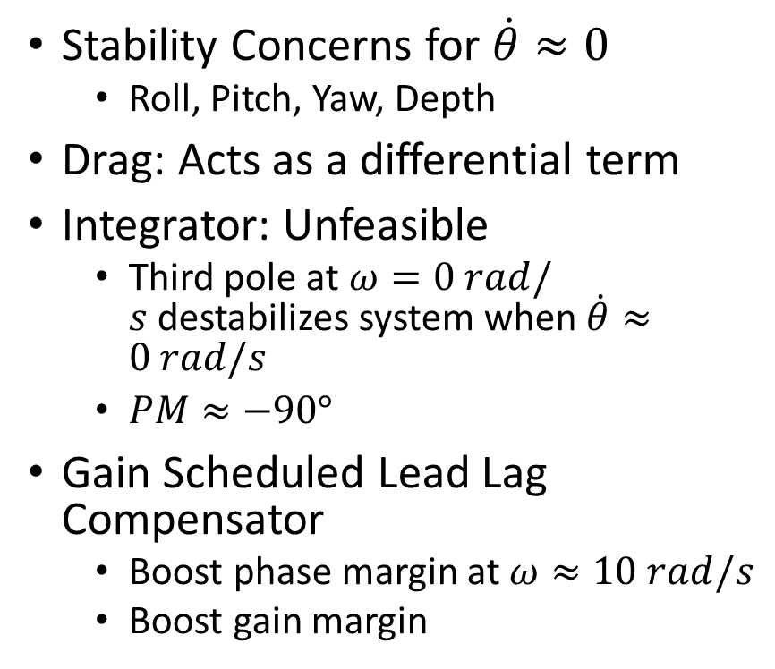
Controller Design
Stability Concerns for $\dot{θ}≈0$
Roll, Pitch, Yaw, Depth
Drag: Acts as a differential term
Integrator: Unfeasible
Third pole at $ω=0 rad/s$destabilizes system when $\dot{θ}≈0 rad/s$
$PM≈−90°$
Gain Scheduled Lead Lag Compensator
Boost phase margin at $ω≈10 rad/s$
Boost gain margin
Compensator.png
compBode.png

